Slide 1
Phonics, reading
and writing in EYFS (Reception Class)

Slide 2
At Bourton-on-the-Water Primary Academy we want to give our children the best possible start. To give a child the gift of reading is to give them the ability to read and learn for the rest of their lives.
‘It’s like learning to ride a bike.
Once you learn how to read
you never forget. It’s a gift for life.’

Slide 3
Children develop awareness of different sounds in spoken language from a very early age.
Spoken words are made up of different sounds. They learn to match these sounds to letters.
Phonics is about children knowing how letters link to sounds.
The children then use this when they are reading and writing.

Slide 4
Read, Write Inc.
In Bourton Primary Academy ,we follow the scheme Read Write Inc.
Approved government scheme.
Before they start
Tuning into sounds
Listening activities
Oral blending and segmenting
Set 1, 2 & 3
Learn sound and letter correspondences
Start to read and spell simple words
Read Write Inc. groups

Slide 5


A bit of technical vocabulary…
Phoneme: The smallest unit of sound in a word.
Grapheme: The letter or letters that represent the phoneme.
a
Special friends
ay
Digraph: two letters that make the same sound.
igh
Trigraph: three letters that make the same sound.

Slide 6
Red words – words that cannot be sounded out:
I, said, they
Green words – words that can be sounded out using our phonics:
cat mat dad top bed
Fred talk – (Fred is the frog) he can only talk in sounds:
sh-o-p
Non-sense words- fake (or alien) words to check their phonics skills/knowledge.

Slide 7
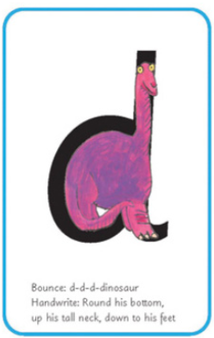
Everyday in school, your child is taught a new sound.
At the end of this session, they should be able to:
Recognise the grapheme; e.g. d
Recognise the grapheme in words; e.g. dog, mud
Write the sound (using the rhyme to remind them
how to write/form it correctly).
E.g. d = round his bottom, up his tall neck, down to his feet

Slide 8
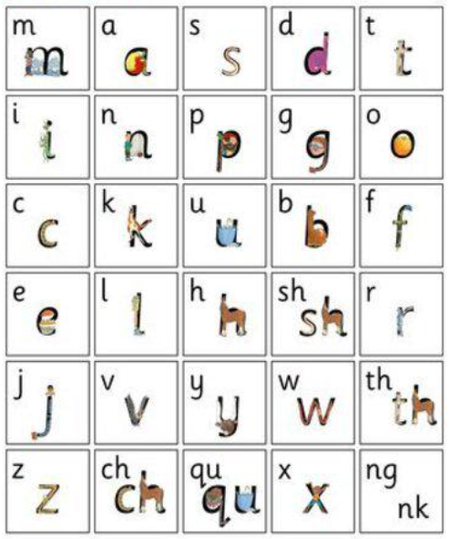
Read,Write, Inc is taught in 3 sets:
Set 1 –
These are the first sounds your child will be
taught in Reception:
Remember each sound is pure…
“m” not “muh”
“t” not “tuh”
It is vital that children say the sounds
correctly as otherwise it may stop them
from reading / blending.

Slide 9
How do phonics help us read?
As they learn to recognise Set 1 sounds, they will be taught to blend / using Fred Talk (put sounds together to hear a word) so that they can begin to read.
Fred talk:
Fred can only talk in sounds...
He says “c_a_t.”
Watch https://www.youtube.com/watch?v=dEzfpod5w_Q
When your child can confidently blend/use Fred Talk,
They will be sent their first ‘Read, Write, Inc book`to practise reading at home.

Slide 10
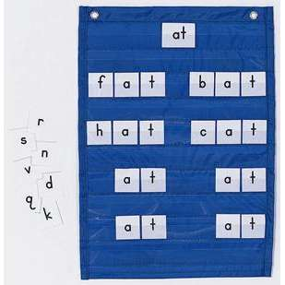
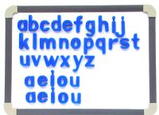

LEARNING TO BLEND AND SEGMENT WITH THE SOUNDS WE KNOW…
Assisted blending
as soon as the first 5
sounds are learnt!
Moving towards
independent
blending
Fred Fingers for spelling
*Say the word and
pinch on the sounds
Eyes for reading,
fingers for spelling!
a
c
t

Slide 11

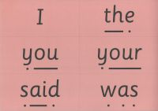
LEARNING TO BLEND AND SEGMENT WITH THE SOUNDS WE KNOW…
Green words – contain all the sounds we know
*Fred talk
*Fred in your head
*No Fred talk
Alien words!
Red words
‘If it’s red it’s hard to Fred’

Slide 12
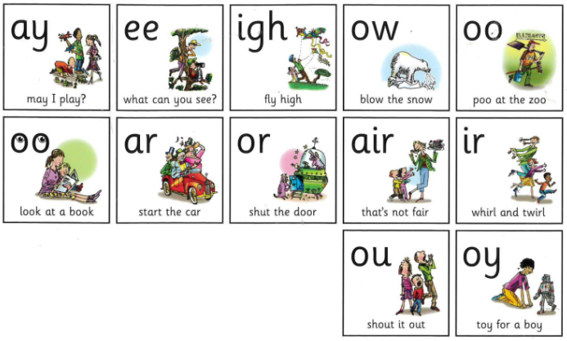
Once your child can
recognise Set 1 sounds
and read them in words,
they will move on to Set 2.
Set 2 has 12 new sounds:
When reading Set 2/3
books with your child,
encourage them to:
Look at a word and find
any special friends before
reading it.
E.g. The night is dark.
n-igh-t d-ar-k

Slide 13
Reading with your child:
Read, Write, Inc recommend reading each book 3 times:
First time = practise decoding the words (blending/Fred Talk).
Second time = practise expression / become quicker / more fluent.
Third time = comprehension (understanding what they have read). Ask questions about what your child has read (see example questions at the back of each book).

Slide 14
When reading with your child at home, they are meant to be consolidating what they have learnt at school, not learning anything new. If they find it too difficult they will not enjoy reading at home. Please let us know.
Don’t forget we are just beginning to learn to read. Everything is new and hopefully exciting!
Every child is an individual, and will learn at their own pace.

