Slide 1

Welcome to our parent workshop
RWI Phonics

Slide 2
What is Read Write Inc. (RWI)?
A systematic phonics programme
Developed by Ruth Miskin
Teaches children to read and write
Focus on speed, accuracy, and fluency

Slide 3
Key Principles of RWI
Daily phonics lessons
Grouped by ability
Consistent routines
Partner work and participation
Emphasis on decoding and comprehension

Slide 4
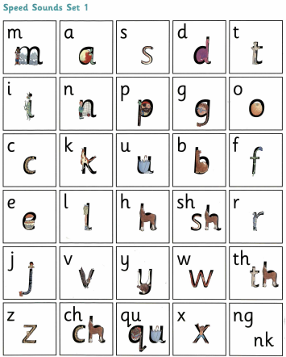
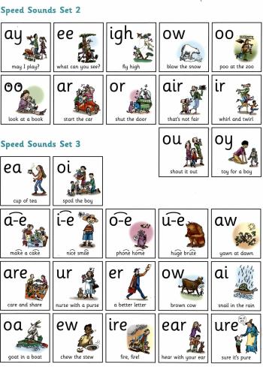
Order of sounds

Slide 5
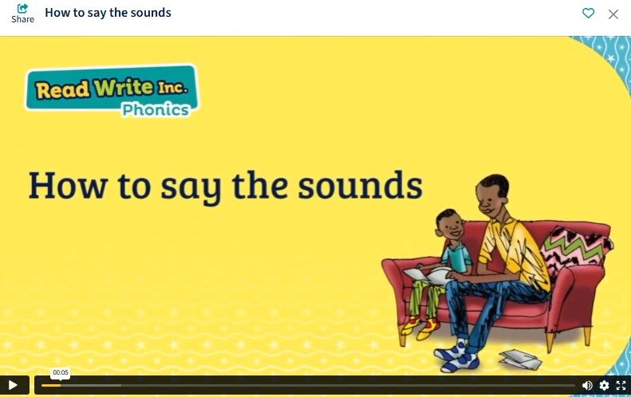
How We Teach Sounds
Set 1, 2, and 3 sounds
Pure sounds pronunciation
Fred Talk (oral blending)
read write inc set 1 sounds video - Google Search

Slide 6
How We Teach Sounds
Introduce/ say the sound
Ruth Miskin Schools Portal
Read the sound
Ruth Miskin Schools Portal
Review the sound
Ruth Miskin Schools Portal
Write the sound
Ruth Miskin Schools Portal
Fred Talk
Ruth Miskin Schools Portal
Notes:
Show parents how we use the sounds to spell words

Slide 7
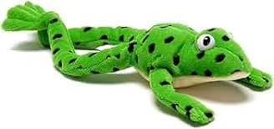

Fred Talk
Children learn to blend sounds:
c-a-t → cat
This supports early reading.
Fred Fingers
We use Fred fingers to pinch the sounds in the words as we spell them.
Notes:
Show an example – have Fred with us

Slide 8
Reading in RWI
Storybooks matched to phonics level
Repeated reading for fluency
Comprehension discussions
Vocabulary development
Notes:
Have the story books out on the table and explain the difference between each book

Slide 9
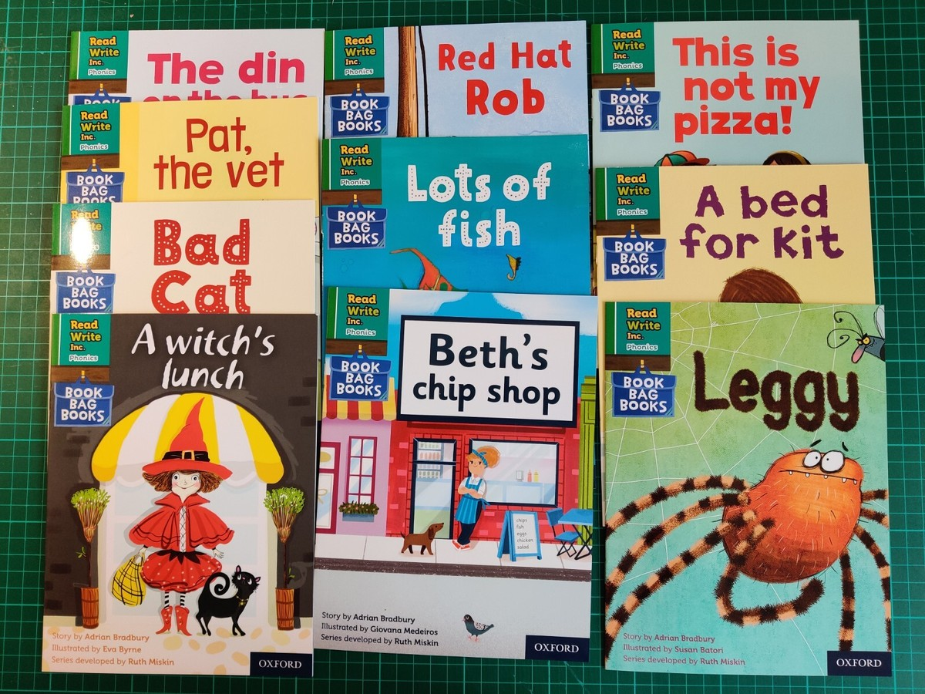
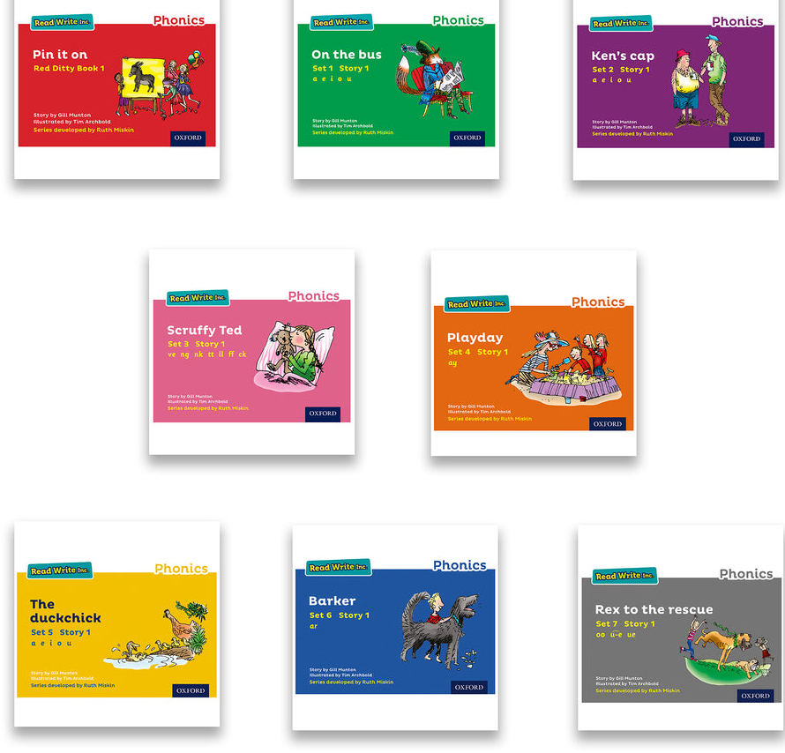
Reading Books for RWI
Book bag books are for you to read at home with your children.
This is the book that your child’s RWI teacher is using in their lessons.
Notes:
Have the story books out on the table and explain the difference between each book.

Slide 10
Writing in RWI
Spell using sounds
Dictation sentences
Focus on handwriting and sentence structure

Slide 11
Assessment in RWI
Regular assessment of sounds by reading teachers and RWI Lead
Children regrouped as needed
Progress tracked closely

Slide 12
How We Support Children
Daily practice
Targeted interventions
Reading at home
Parental support

Slide 13
How Parents Can Help
Practice sounds daily
Read regularly
Encourage blending
Use school resources

Slide 14

Any questions?

