Slide 1
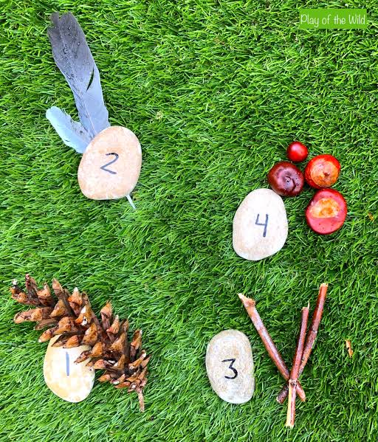
Maths in Reception
Building strong mathematical foundations through play, talk and everyday experiences

Slide 2
Our aim
• Help children develop a deep understanding of number
• Build confidence using mathematical language
• Learn through practical experiences and play
• Develop reasoning and problem-solving skills
• Make maths meaningful in everyday life

Slide 3
What is the Early Learning Goal (ELG)?
Number
• Have a deep understanding of number to 10, including the composition of each number
• Subitise (recognise quantities without counting) up to 5
• Automatically recall number bonds up to 5 (including subtraction facts) and some number bonds to 10, including double facts
Numerical Patterns
• Verbally count beyond 20, recognising the pattern of the counting system
• Compare quantities up to 10
• Explore and represent patterns within numbers up to 10, including odds and evens, double facts and sharing

Slide 4
What does 'deep understanding of number' mean?
It is more than being able to recite numbers.
Children need to understand:
• How many objects there are
• That the last number counted tells us how many
• That numbers can be represented in different ways
• That numbers can be compared
• That numbers can be made in different ways
We want children to explain their thinking, not just give an answer.

Slide 5
Subitising – What is it?
Subitising means recognising how many objects are in a small group without counting them one by one.
For example, seeing ●●● and knowing there are 3.
We develop this through:
• Dice and dominoes
• Fingers
• Ten frames
• Dot cards
• Objects arranged in familiar patterns

Slide 6
Why is subitising important?
Subitising helps children to:
• Develop strong number sense
• Recognise quantities quickly
• Notice patterns and relationships
• Build towards addition and subtraction
• Develop confidence with numbers
Ask: “How did you know there were 4?” rather than simply “How many?”

Slide 7
The composition of numbers
Composition means understanding that a number is made up of smaller parts.
For example:
5 can be 4 and 1
5 can be 3 and 2
5 can be 2 and 3
5 can be 1 and 4
The whole stays the same even when the parts change.

Slide 8
Seeing composition in everyday life
Try practical examples:
🍎 “We have 5 apples. 2 are red and 3 are green. How many altogether?”
🧸 “There are 6 teddies. 4 are on the bed and 2 are on the floor.”
🖐 “Show me 5 fingers. Can you show 5 another way?”
The important part is talking about the parts and the whole.

Slide 9
Part–part–whole
A useful model for developing composition:
PART + PART = WHOLE
For example:
2 + 3 = 5
But children should also experience this physically:
●● + ●●● → ●●●●●
Use objects first, then pictures and eventually numerals.

Slide 10
How we teach maths in Reception
We move from:
Concrete → Pictorial → Abstract
🧱 Objects children can touch and move
↓
🖼 Pictures, drawings and representations
↓
🔢 Numerals and mathematical symbols
Children need lots of opportunities to explore before we expect formal recording.

Slide 11
Mathematical language matters
Use and model words such as:
• more / fewer / same
• greater / smaller
• altogether
• part / whole
• equal
• pair
• double
• share
• number bond
• how many?
• how do you know?
Encourage children to explain their thinking.

Slide 12
Maths at home – simple ideas
• Count stairs, toys, plates or socks
• Play dice and board games
• Spot numbers when out and about
• Ask “How many will there be altogether?”
• Use fingers to make different numbers
• Look for patterns
• Share snacks fairly
• Compare groups: “Who has more?”
• Notice shapes and quantities in the environment

Slide 13
Questions that develop mathematical thinking
Instead of always asking “What is 5 + 2?” try:
“What do you notice?”
“How do you know?”
“Can you show me another way?”
“Can you see it without counting?”
“What would happen if I added one more?”
“Can you make 6 in two different ways?”
“Which group has more? How do you know?”

Slide 14
A quick activity to try together
Take 5 small objects.
1. Show your child 5.
2. Hide some in your hand.
3. Ask: “I have 2 here. How many are hiding?”
4. Encourage them to explain how they know.
5. Change the parts and repeat.
This develops composition, subitising and early addition/subtraction thinking.

Slide 15

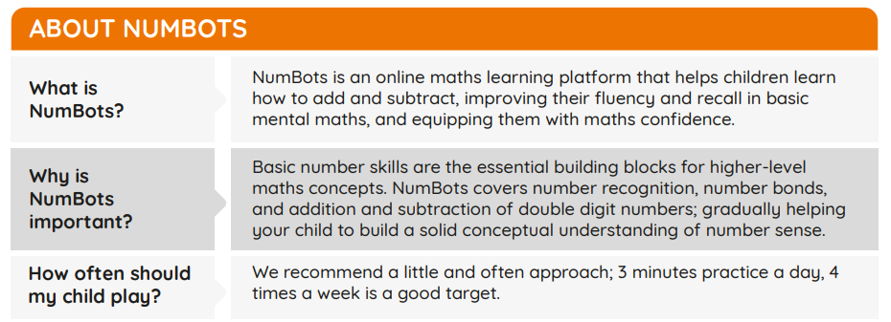
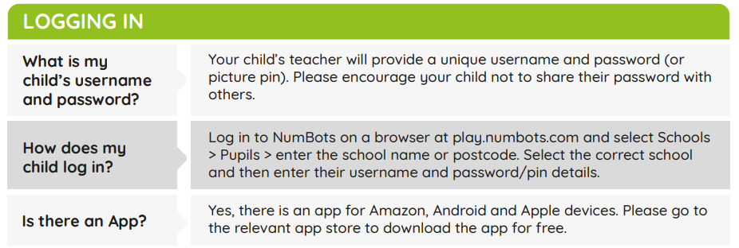
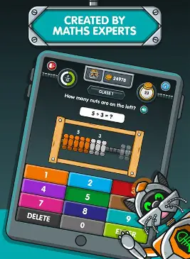
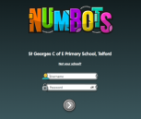

Slide 16
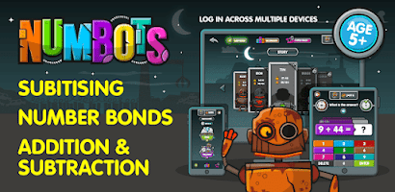
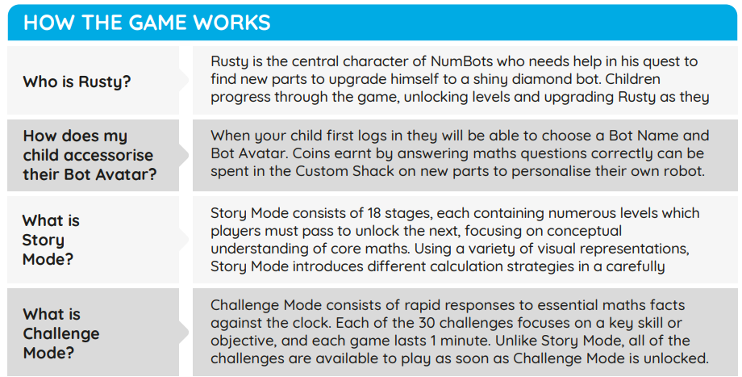
Children will have the opportunity to access this in school once a week, and it is expected they access it at home daily, alongside their daily reading.

Slide 17
Key messages for parents
⭐ Maths is everywhere.
⭐ Talk about numbers during everyday activities.
⭐ Let children use objects and their fingers.
⭐ Ask children to explain how they know.
⭐ Encourage different ways of making numbers.
⭐ Mistakes are valuable opportunities for learning.
⭐ Keep maths playful and enjoyable.

Slide 18
Thank you!
Thank you for supporting your child's mathematical development.
Questions?
“Every child can be a mathematician.”

