Slide 1
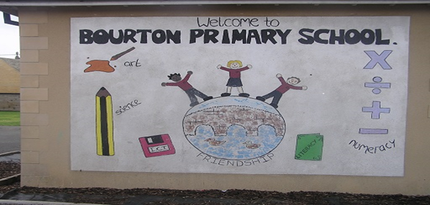

WELCOME TO BOURTON-ON-THE-WATER
PRIMARY ACADEMY

Slide 2
Reception new starter pack
Information for parents to keep:
  Attendance guidance.
  Acceptable computer use and internet rules.
  Free school meals information.
  Bourton Primary Academy uniform information.
  Wrap around care information (breakfast/afterschool club).
  Illness.
  Homework
  Aspen example menu.

Slide 3
Reception new starter pack
Forms to be signed and returned to school by Tuesday 30th June:
  Data collection form.
  Photo permission form.
  Home/school partnership agreement.
  Wrap around care information (breakfast/afterschool club).
  All about me form.

Slide 4
Overview of the curriculum
In EYFS, we follow the Development Matters (2021) framework. Through a mixture of adult led, adult directed and child initiated learning we cover the seven areas of learning and plan for the characteristics of effective teaching and learning.
In RWInc Phonics, EYFS children learn to say a sound for all the letters of the alphabet, as well as for many digraphs and trigraphs. Children learn to blend sounds in order to read words and segment the sounds in order to spell words phonetically. Children also learn a number of “red words”.
In Maths, EYFS children explore numbers 1 to 10 in depth, learning to count, subitise, recognise, compare and compose the numbers, as well as learning to recall addition and subtraction facts for the numbers up to 10. Children also explore shape, space and measure.
NUMBOTS.- NumBots is an online Maths learning platform that helps children learn how to add and subtract, improving their fluency and recall in basic mental maths, and equipping them with Maths confidence. We will hold a meeting in September!

Slide 5


The Early Years Foundation Stage
There are seven areas of learning
Communication
and
Language
Personal, Social and Emotional
Development
Physical Development
Mathematics
Understanding the
World
Expressive Arts and Design
Literacy

Slide 6





How you can prepare your child for school
Talk to your child about starting school. Maybe retell some of your early memories and the fun you had at school, and if possible share a photo of you at school too.
Talk to your child about what they are looking forward to, as well as any worries they have. Don’t ignore these worries! Reassure them that the teachers are there to help and to talk to.
Ensure bedtime routines are in place before starting school.
Try on their school uniform – this is always exciting!!

Slide 7




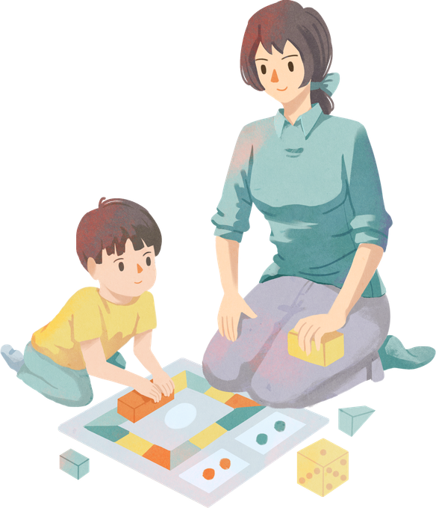
How you can help at home.
Provide opportunities for chatting, playing and interacting together.
Spend time together reading, telling stories and singing.
Spend time together talking about school.
Encourage independence – getting dressed, putting on coat and shoes, washing/ drying hands and using the toilet.
Play games that involve turn taking.

Slide 8
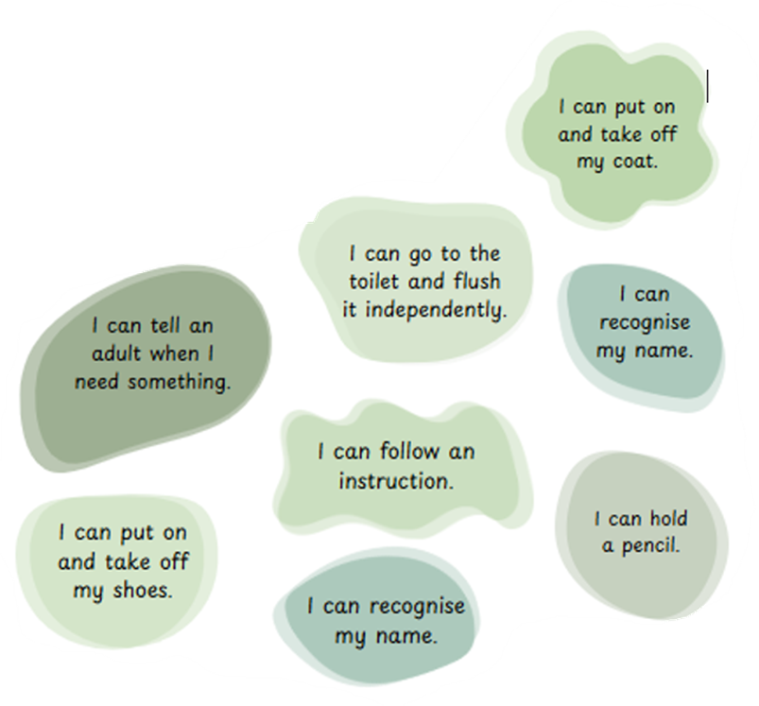
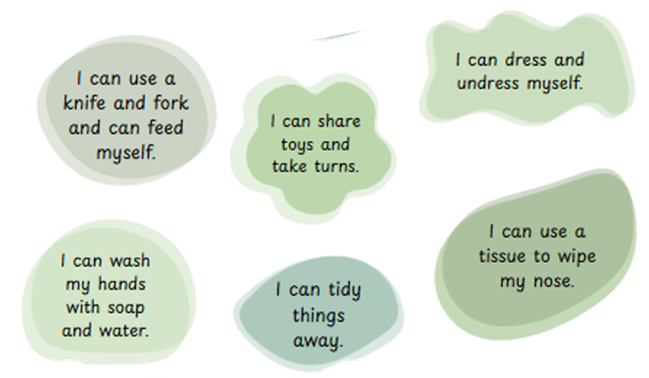
Getting ready for school!
It would be extremely helpful if your child can do the following tasks before they start school.

Slide 9

PRACTICAL DETAILS
  Please ensure ALL uniform and book bags are labelled with child’s name.
  PE kits will stay at school (taken home every half term)
  Weather dependent clothes – coats, hats, wellies etc.
  Packed lunches in a named lunch box – HEALTHY LUNCH!
  Water bottle named. Water only!
  We provide fruit for snack at break time.
  Children may have “accidents”. Please provide a spare pair of pants, trousers/skirt…
  Please check book bags regularly for letters/homework/notes from teacher.
  Letters are normally sent via IPAL.
  Ensure we have the correct medical information and are aware of any allergies ASAP.

Slide 10





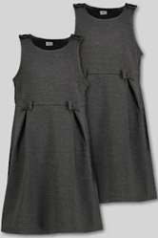



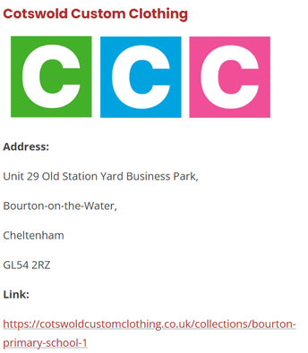
Uniform – NAMED
PE Kit – NAMED
More information in your packs and school website.

Slide 11
Communicating with school
  Face to face with staff- beginning /end of every day.
  Appointments.
  IPAL
  Letters
  Phone call to the office.
  WEBSITE

Slide 12

Home time
At home time children are picked up from Reception class door by an adult known to the teacher. You must inform us of any change of arrangements.

Slide 13
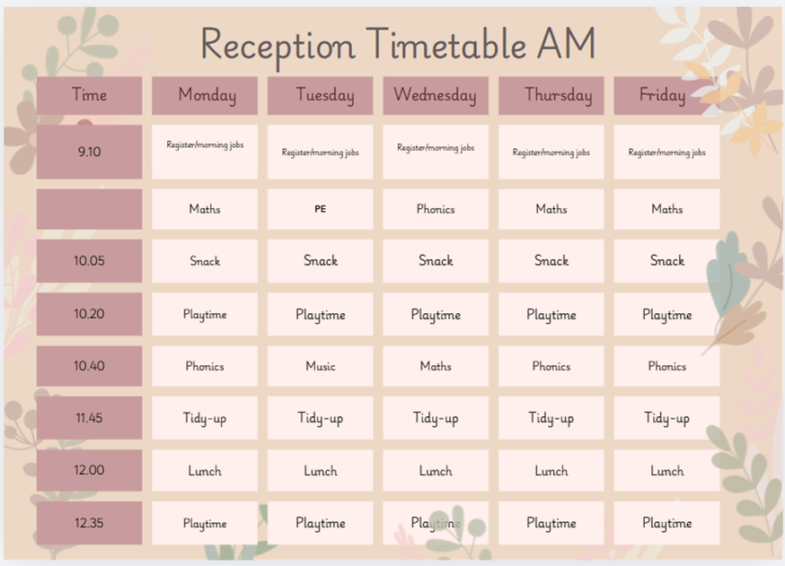
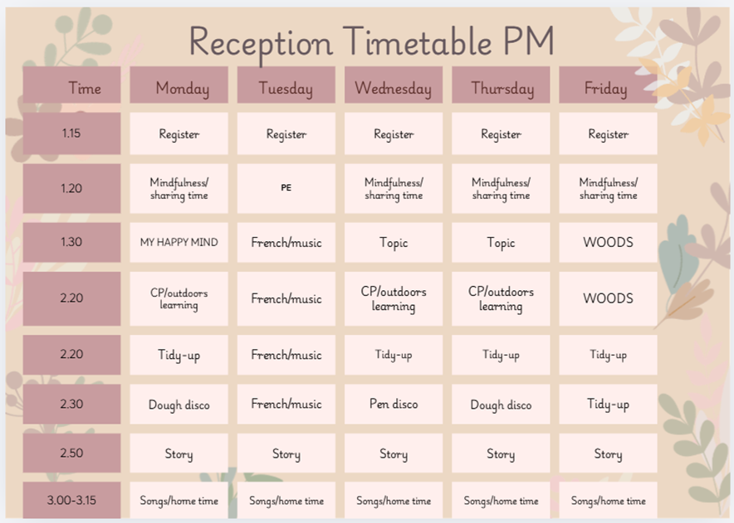
A typical day in Reception
Fruit and milk. In Reception we have ‘snack and chat’/‘snack and story’ daily where the children sit together and have fruit.

Slide 14

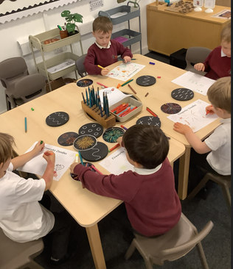
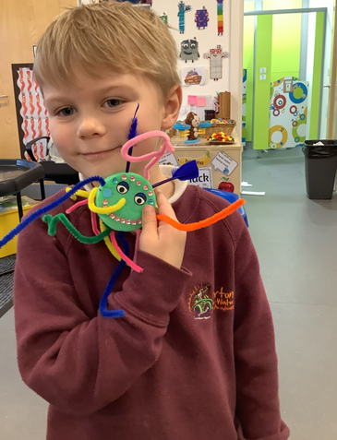
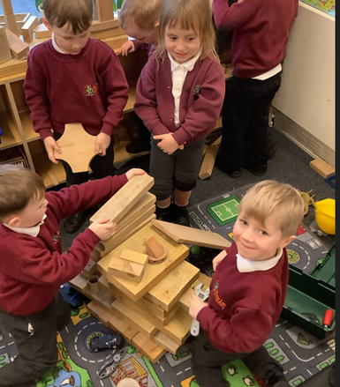
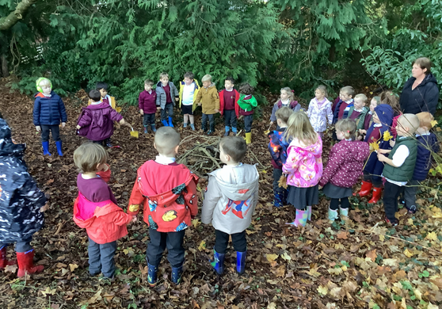
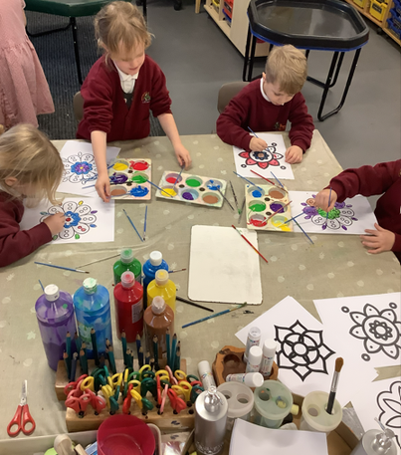
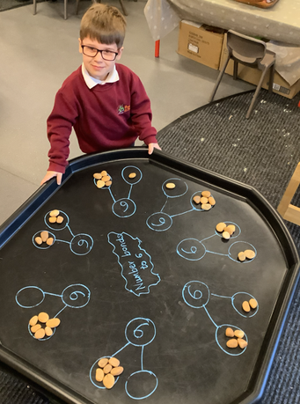
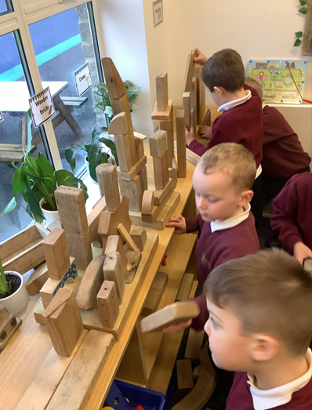
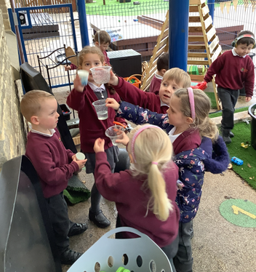
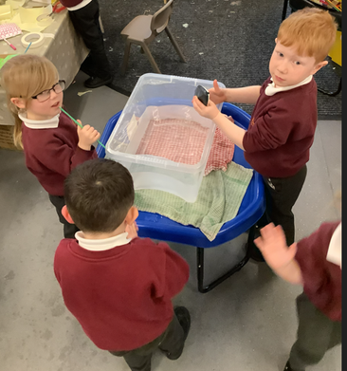
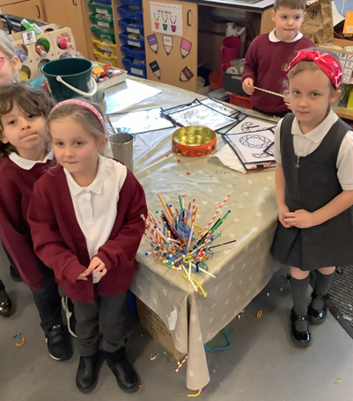
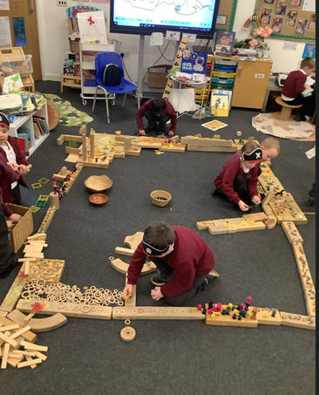
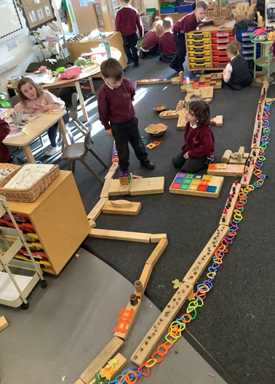
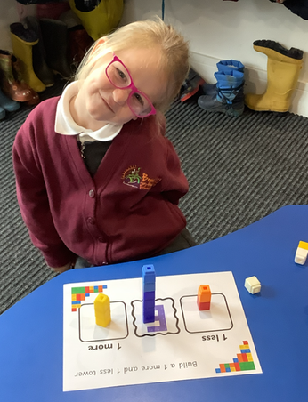
What did you do at school today?
Nothing!

Slide 15
IMPORTANT DATES
STAY AND PLAY SESSIONS
Tuesday 16th June 2026 1:30 to 2:30
Tuesday 23rd June 2026 1:30 to 2:30
SEPTEMBER
Reception will start on 7th September 8:45am – 3:15pm.
The teachers will be available in school on the 2nd, 3rd and 4th September, if you would like to arrange a 1:1 meeting for any discussions or to answer any questions you may have.
The office will set up an appointment calendar that you can sign up for.

Slide 16
All About Me bag
Throughout the first term our theme will be ‘All About Me’. Over the Summer holidays we would like the children to fill the “All About Me Bag” with items that are special to them, e.g:
• Photo of their family.
• Favourite teddy.
• Photo of a pet.
• Favourite toy.
• Photo of their favourite place.
Please bring these to school in the first week in September.

Slide 17

Thank you!
We are really looking forward to getting to know you and your children and we hope you are excited too!
Thank you!
It's going to be a great year.

