Slide 1
Phonics, reading
and writing in EYFS (Reception Class)

Slide 2
LEARNING TO READ…
‘It’s like learning to ride a bike!
Once you learn how to read
you never forget. It’s a gift for life.’

Slide 3
END OF RECEPTION EXPECTATIONS IN READING
Children read and understand simple sentences.
They use phonic knowledge to decode regular words and read them aloud accurately.
They also read some common irregular words, such as ‘the’ and ‘was’.
They demonstrate understanding when talking with others about what they have read.

Slide 4

WHAT IS PHONICS?
Phonics is a systematic method of teaching reading and writing for children from nursery to 9, or an age where it is still needed.
The teaching of phonics helps to create fluent readers and willing writers from an early stage.
Our school uses the RWI phonics scheme.

Slide 5
SOUNDS NOT LETTER NAMES
• Although knowing the letter names are important we focus on the sound that the letter makes.
• We say the purest sound that each letter makes – try to make it a short sound.
• If it helps think of how the letter sounds at the end of a word e.g.
m – a – t

Slide 6
TEACHING SOUNDS
The first thing we teach children is the correct pronunciation of sounds.
This prevents children from reading and writing words incorrectly.
We call these sounds “pure” sounds.
These need to be pronounced correctly to avoid the children spelling words incorrectly e.g. children incorrectly write words as “fuh” instead of “f”.

Slide 7
KEY WORDS
Red words – words that cannot be sounded out:
I, said, they
Green words – words that can be sounded out using our phonics:
cat mat dad top bed
Fred talk – (Fred is the frog) he can only talk in sounds:
c-a-t
Fred Fingers - we use Fred Fingers to help children sound out words to spell easily.
Nonsense words - fake (or alien) words to check their phonics skills/knowledge.

Slide 8
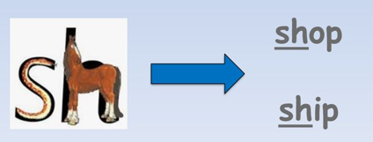
Special friends
As children progress through the programme they will be introduced to some sounds that are represented by two or three letters. The children may refer to these as “special friends” as they like to be together.

Slide 9
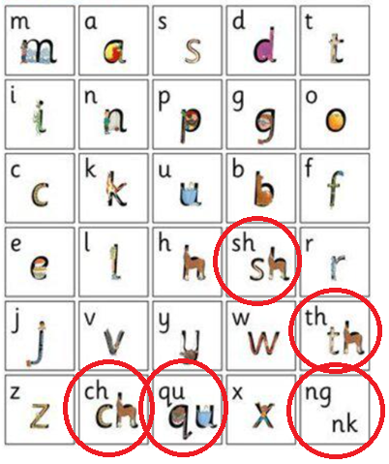
Read,Write, Inc is taught in 3 sets:
Set 1 –
These are the first sounds your child will be
taught in Reception:
Remember each sound is pure…
“mmm” not “muh”
“t” not “tuh”
It is vital that children say the sounds
correctly as otherwise it may stop them
from reading / blending.
When reading words with ‘special friends’, encourage your child to:
Find special friends before reading the whole word.
E.g. The shop sells fish and chips.

Slide 10
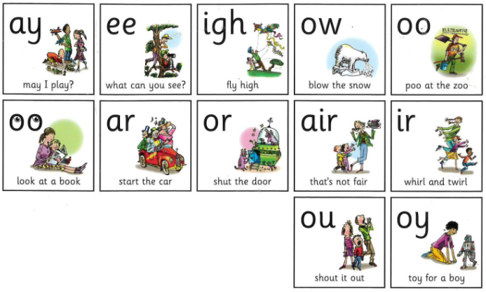
Once your child can recognise Set 1 sounds and read them in words, they will move on to Set 2.
Set 2 –
Has 12 new sounds:
When reading Set 2/3
books with your child,
encourage them to:
Look at a word and find
any special friends before
reading it.
E.g. The night is dark.
n-igh-t d-ar-k

Slide 11
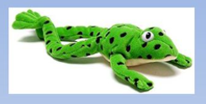
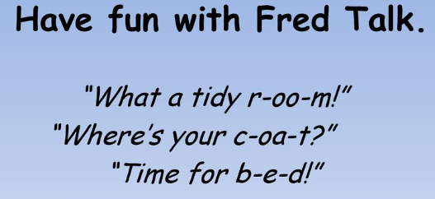
Meet Fred!
Fred can only talk in sounds…
He says “c-a-t” and the children then blend (combine the sounds) to read and reveal the word.
We call this Fred talk.

Slide 12
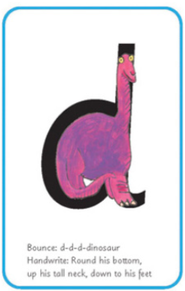
Everyday in school, your child is taught a new sound.
At the end of this session, they should be able to:
Recognise the sound; e.g. d
Recognise the sound in words; e.g. dog, mud
Write the sound (using the rhyme to remind them
how to write/form it correctly).
E.g. d = round his bottom, up his tall neck, down to his feet.

Slide 13
Our teaching order
• We do not teach the sounds in
alphabetical order.
• The order is special – the sounds are taught in blocks of 5, then at the end of each block there is a word section.
All of the words contain the sounds they have learnt.
The first set of sounds….
• The first sounds we are teaching your child are:
m a s d t
• Words that can be made with these sounds are:
at, mat, dad, sad, sat, mad

Slide 14
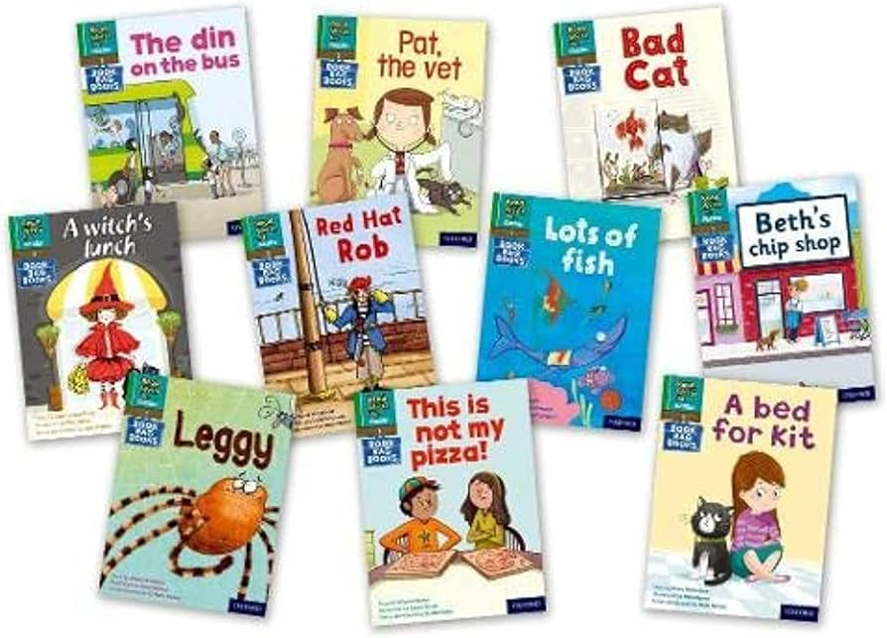
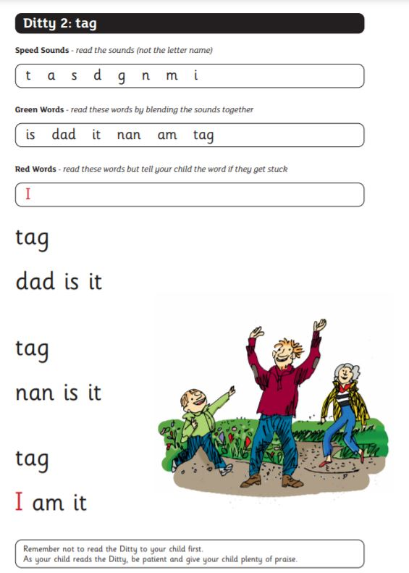
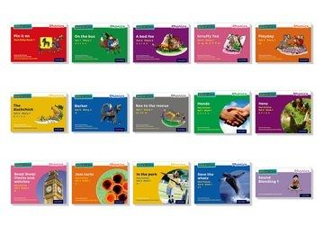
BOOKS
- Picture books
- Sound blending books
- Ditty sheets

Slide 15
Reading with your child:
Read, Write, Inc recommend reading each book 3 times:
First time = practise decoding the words (blending/Fred Talk).
Second time = practise expression / become quicker / more fluent.
Third time = comprehension (understanding what they have read). Ask questions about what your child has read (see example questions at the back of each book).

Slide 16
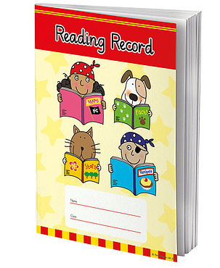
Reading Records
Reading Records are essential for communication between school and home. It is important that you teach your child to take care of their Reading Record and reading books.
Please sign / put a comment / smiley face to indicate that they have read their book 3 times (so that we know that they are ready to change it).

Slide 17
When reading with your child at home, they are meant to be consolidating what they have learnt at school, not learning anything new. If they find it too difficult they will not enjoy reading at home. Please let us know if this is the case.
Don’t forget we are just beginning to learn to read. Everything is new and hopefully exciting!
Every child is an individual, and will learn at their own pace.

Slide 18


Slide 19
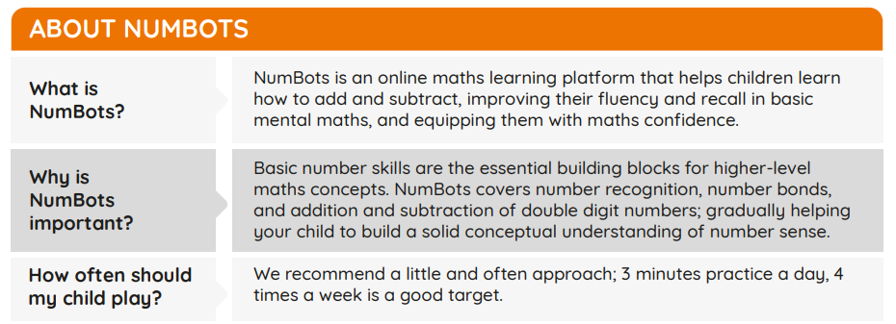
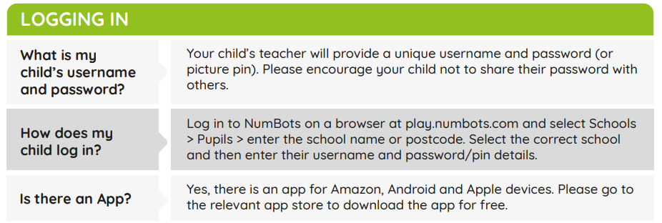

Slide 20
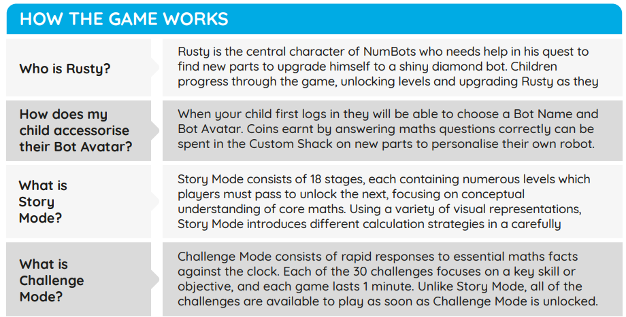
This parent guide can be found on our class pages, and has some additional information on it.
Children will have the opportunity to access this in school once a week, and it is expected they access it at home daily, alongside their daily reading.

