Slide 1
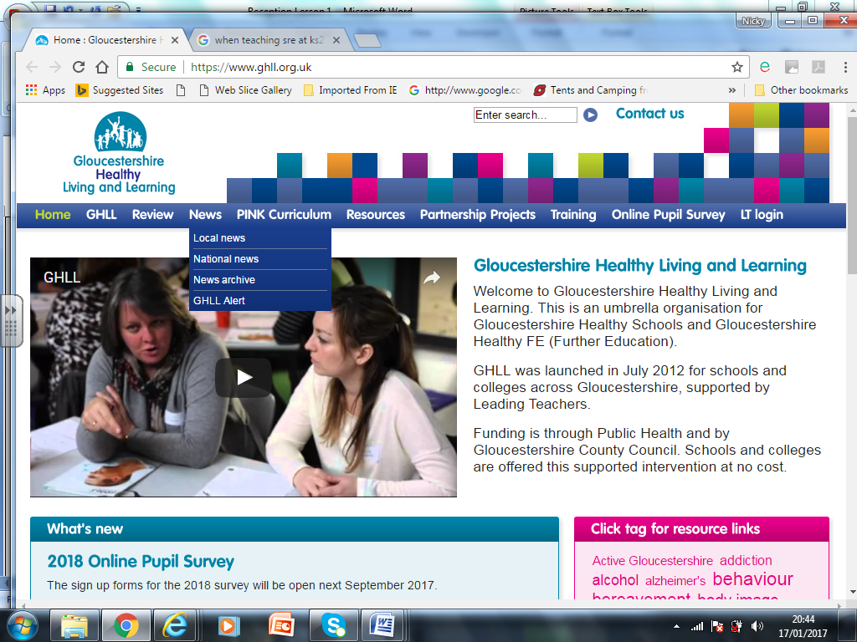
RSE
(Relationships and Sex Education)
Parent Consultations
Part of our Wellbeing Curriculum

Slide 2
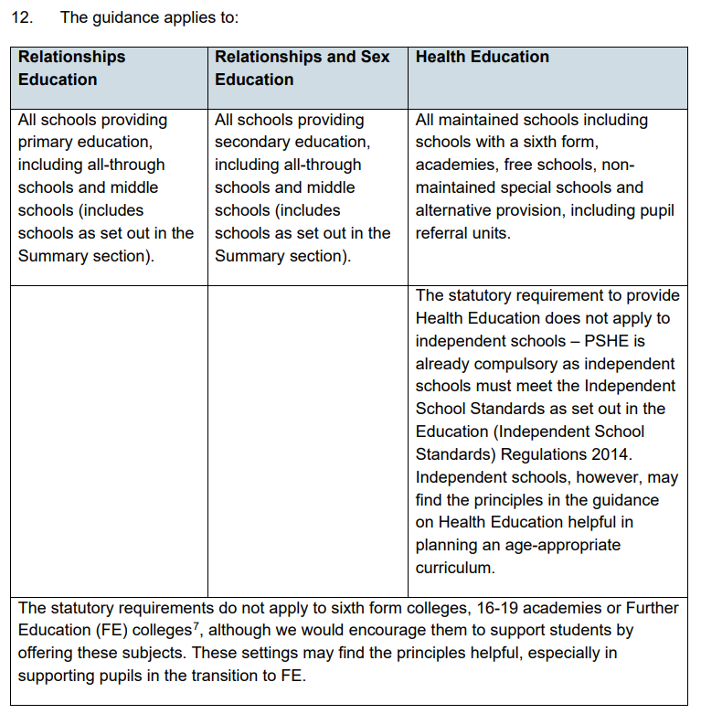
Why teach RSE?
DfE Guidance:
Rationale
The focus in primary school should be on teaching the fundamental building blocks and characteristics of positive relationships, with particular reference to friendships, family relationships, and relationships with other children and with adults.
(Relationships education (Primary) - GOV.UK (www.gov.uk) DfE, 2019)
There must be a whole-school approach to supporting pupils to be safe, happy and prepared for life beyond school. At the heart of everything is supporting children’s personal development; which is multi-faceted.
The importance of this has been recognised and, since 2019, RSE has been a compulsory subject, along with Health Education in both Primary and Secondary settings.
Nothing has changed since the initial parent consultations carried out in 2019, this is an opportunity to share resources and discuss any questions.
Relationships Education, Relationships and Sex Education and Health Education guidance (publishing.service.gov.uk)

Slide 3
What is RSE?
The Relationships Sex Education Hub define RSE as learning about ‘the emotional, social and physical aspects of growing up, relationships, sex, gender, sexuality and sexual health and is tailored according to age, and physical and emotional maturity of the children and young people it is delivered to.’
‘High quality RSE ensures children and young people are equipped with the knowledge, understanding, skills and confidence to cope with the many pressures and challenges of modern society [and] to help children to understand themselves and others.’ (RSE Hub | Home).
Lessons taught should equip children and young people with the information, skills and positive values to have safe, fulfilling relationships, and to take responsibility for their sexual health and wellbeing.
Lessons are tailored according to age, and physical and emotional maturity of the children and young people they are delivered to.
The RSE Hub is an online resource that provides credible and useful support for educators in all aspects of RSE.

Slide 4
National Curriculum Expectations:
‘Relationships Education, RSE and Health Education complement several national curriculum subjects. Where schools are teaching the national curriculum, they should look for opportunities to draw links between the subjects and integrate teaching where appropriate; [as such, our RSE Curriculum will be covered within other lessons, including Science, PE and IT.] There continues to be no right of withdrawal from any part of the national curriculum.’
‘At key stages 1 and 2, the national curriculum for science includes teaching about the main external parts of the body and changes to the human body as it grows from birth to old age, including puberty.’ (DfE, 2019)

Slide 5
The Teaching of RSE:
Ground Rules will be set by all teaching staff, which will include respecting others’ opinions and values. Children will be reminded of the ground rules before every teaching session.
Appropriate direct questions will be answered by teaching staff in an open, factual and age-appropriate way. All children will have the opportunity to ask questions within the group.
Confidentiality: Where any disclosure is shared, and it is felt a child may be at risk, all staff will follow the school’s Safeguarding Policy. Pupils will not be promised secrecy and class teachers will ensure all discussions are handled professionally.
Use of Terminology: At Bourton, we believe in order to best safeguard children, when teaching Relationships and Health Education, staff must consistently use correct anatomical vocabulary with the children throughout the school. The vocabulary used in lessons has already been reviewed by the PSHE co-ordinator and Co-Heads and has been consulted with staff and governors.

Slide 6
The Teaching of Relationships and Sex Education:
Families and people who care for me
Caring friendships
Respectful relationships
Online relationships
Being safe
All pupils of Bourton Primary will, at points developmentally appropriate, participate in the statutory ‘Relationships Education’ curriculum. Lessons will be taught in the classroom by a trusted adult.

Slide 7
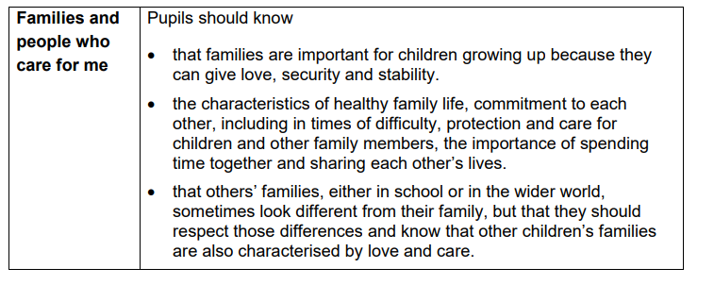
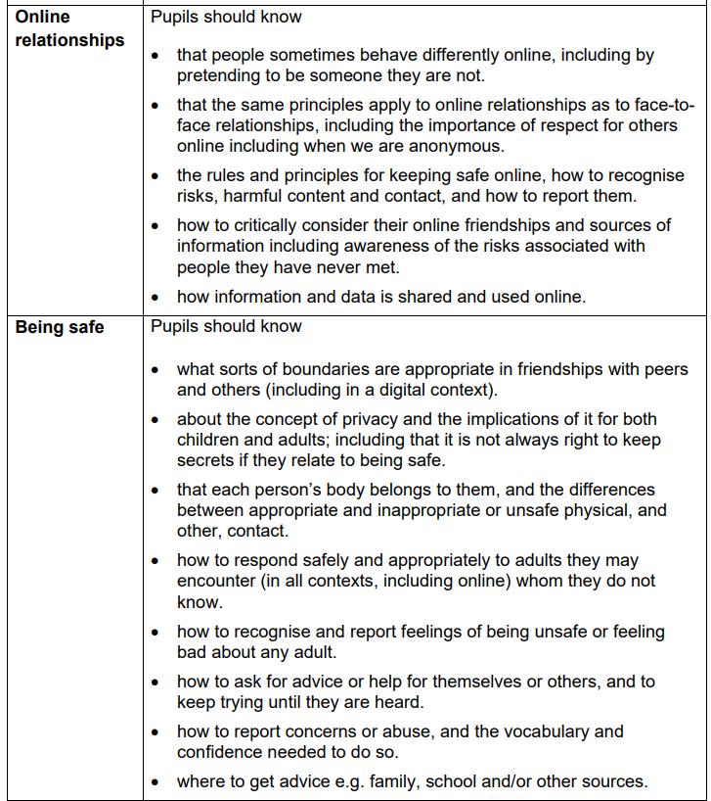
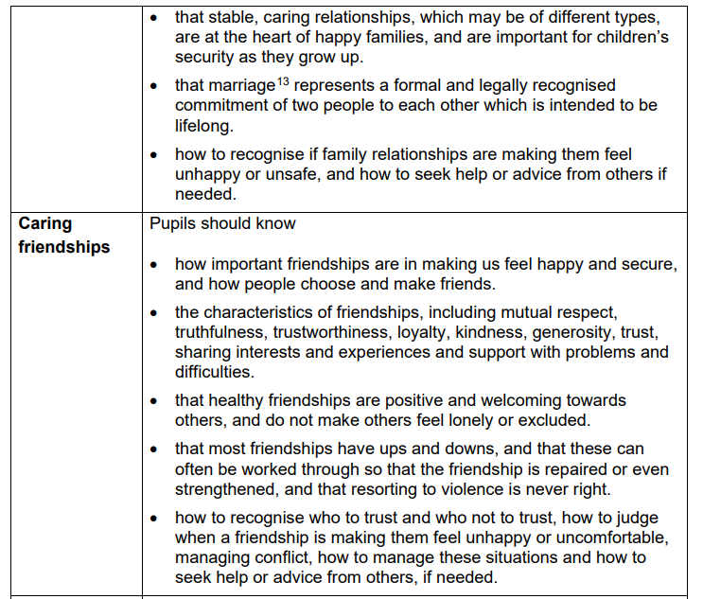
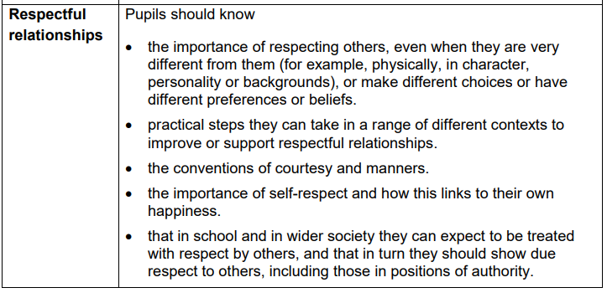
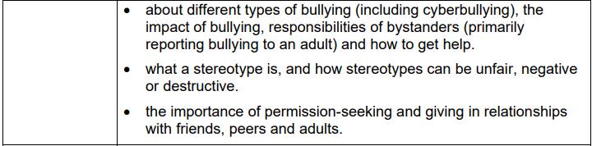
Statutory end of primary statements.
https://www.gov.uk/government/publications/relationships-education-relationships-and-sex-education-rse-and-health-education

Slide 8
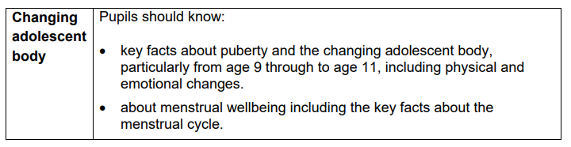
Physical Health and Mental Wellbeing
Mental health and wellbeing
Internet safety and harms
Physical health and fitness
Healthy eating
Drugs, alcohol and tobacco
Health and prevention
Basic first aid
Changing adolescent body
https://www.gov.uk/government/publications/relationships-education-relationships-and-sex-education-rse-and-health-education
Whilst puberty, including menstruation, are statutory areas of learning for all children, as part of Health Education, the following slides discuss content that is not statutory, but schools can choose to teach.

Slide 9
Sex Education
What is covered in the Science Curriculum?

Slide 10
RSE covered in KS1
Science National Curriculum
Year 1: (statutory requirements)
Animals, including humans
→ identify, name, draw and label the basic parts of the human body and say which part of the body is associated with each sense.
Year 2: (statutory requirements)
Animals, including humans
→ notice that animals, including humans, have offspring which grow into adults.
→ describe the importance for humans to exercise, eating the right amounts of different types of food, and hygiene.

Slide 11
RSE covered in KS2
Science National Curriculum
Year 5: (statutory requirements)
Animals, including humans
describe the changes as humans develop to old age.
Year 6: (statutory requirements)
Evolution and Inheritance
recognise that living things produce offspring of the same kind, but normally offspring vary and are not identical to their parents.
Notes:
Sc5/2.1 Living Things and their habitats
Sc5/2.1a describe the differences in the life cycles of a mammal, an amphibian, an insect and a bird

Slide 12
Right to withdraw
Parents and carers do not have the right to withdraw their children from relationships education, health education or National Curriculum science. Parents do have the right to request that their child be withdrawn from some or all of sex education delivered as part of statutory RSE. This resource does include teaching and learning about how babies are conceived and born. This could be considered to be sex education that is outside of the science curriculum.
Before granting any such request, a discussion with Co-Heads would need to take place to discuss the request with parents and, as appropriate, with the child to ensure that their wishes are understood and to clarify the nature and purpose of the curriculum. In the event of a child being withdrawn from a lesson, that child must stay in school and will be assigned to another class until the relevant lesson is over. Schools will want to document this process to ensure a record is kept.
Optional opt out lessons taught in Y5:
- Wet Dreams and Masturbation
Optional opt out lessons taught in Y6:
- Making Babies (sexual intercourse)
- Making Babies (assisted fertility)
- Making Babies (pregnancy and birth)
Statutory lessons taught under the health curriculum
- Year 2: Personal and Private Body Parts and Keeping Safe
- Year 4: Periods (menstruation)
- Years 4 and 6: Changes at Puberty

Slide 13
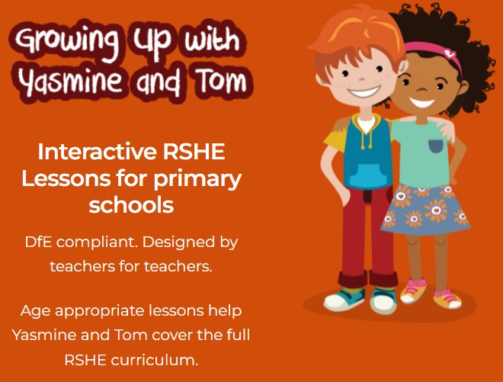

Teaching Resources:
We will be using a mixture of GHLL resources alongside the Family Planning Association. All are DfE compliant, designed by teachers for teachers.
https://youtu.be/I25K1ytJIho

Slide 14
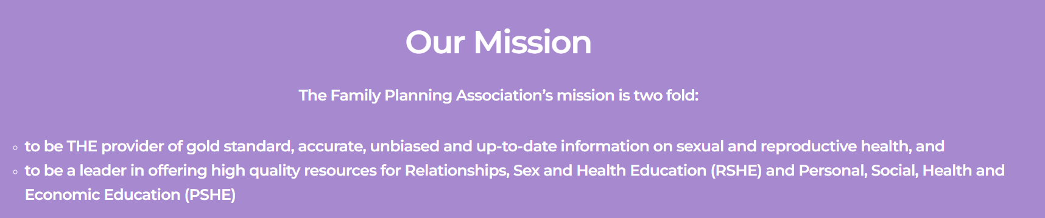
The next few slides show examples of the resources that will be used in lessons. (There are also handouts to look at after the session.)

Slide 15
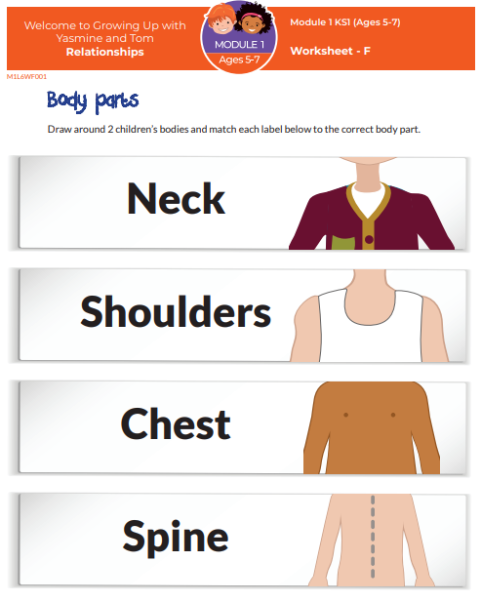
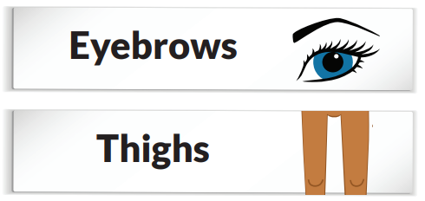
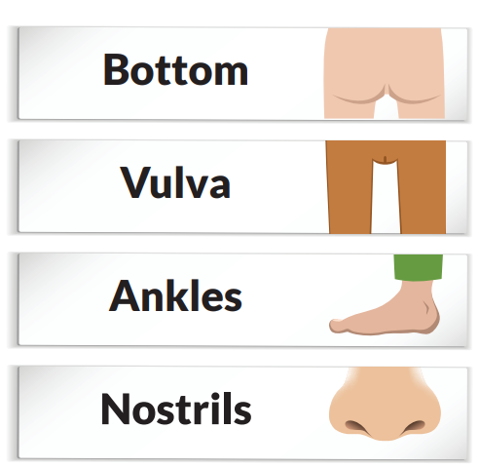
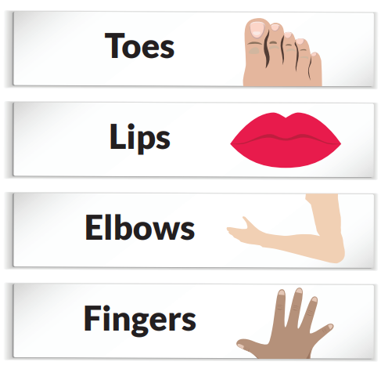
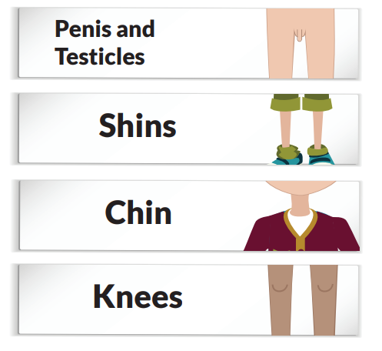
Year 2 Lesson –
Personal and private body parts (keeping safe).
Aim of lesson
To be able to name their personal and private body parts, in a safe space, confidently.
To understand what ‘private’ means.
Learning outcome
I can name the different parts of my body including the private and personal body parts.
I can explain what private and personal parts are and how they are identified.

Slide 16
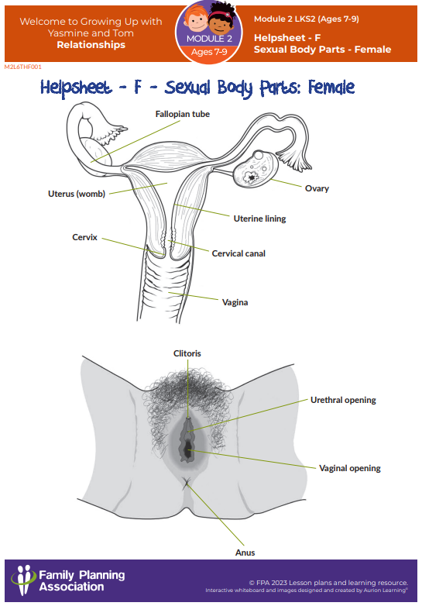
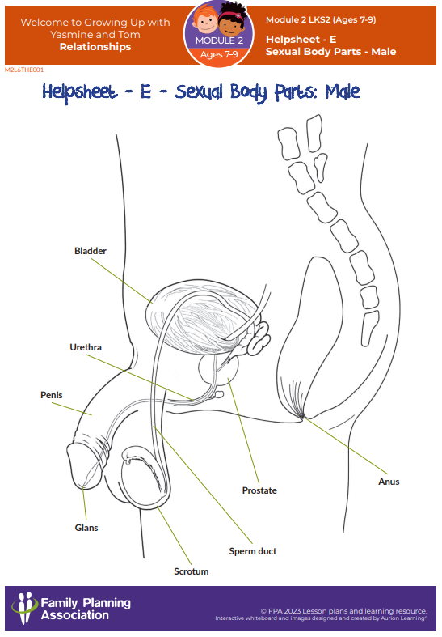
Year 4 Lesson – Personal and private body parts (keeping safe).
Aim of lesson
To reinforce language for the personal and private parts of the body and to explore ideas of safe touch, personal space and consent.
Learning outcome
I can label the personal and private parts of bodies.
I can explain the difference between safe and unsafe touches.
I know that no one has the right to touch us in a way that feels unsafe not even someone in our family.

Slide 17
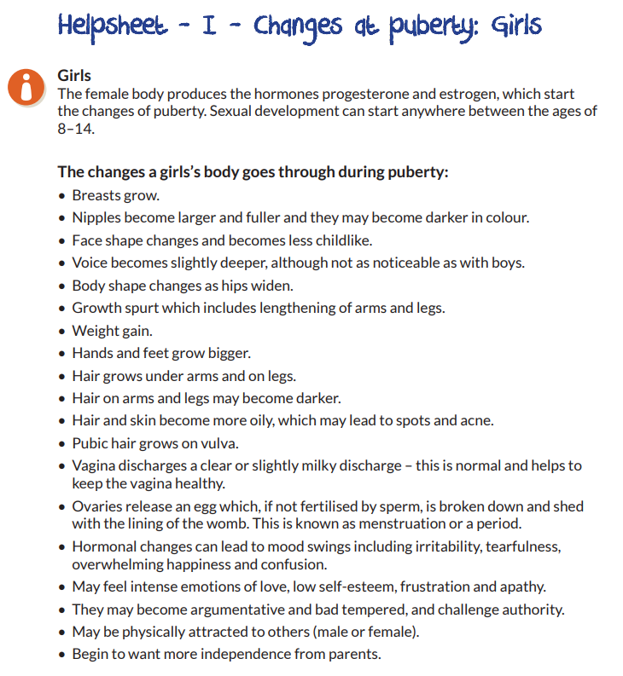
Year 5 Lesson – Changes at Puberty
(Period – Menstruation in Y4)
Aim of lesson
To learn about periods (menstruation).
Learning outcome
I can explain what a period (menstruation) is.
I can suggest ways to overcome possible problems from periods.
Lil-lets video resources and www.always.co.uk (linked via GHLL)
Aim of lesson
To understand physical and emotional changes at puberty.
Learning outcome
I can identify some of the changes that will happen in my body and other bodies during puberty.
I can describe who to talk to when I need help dealing with the changes at puberty.
I can ask for support for any changes that are difficult to manage.

Slide 18
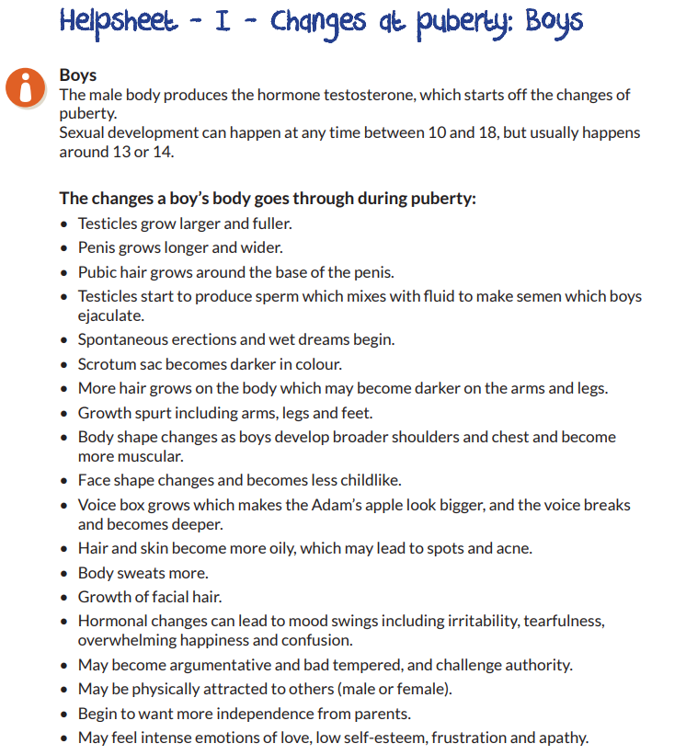
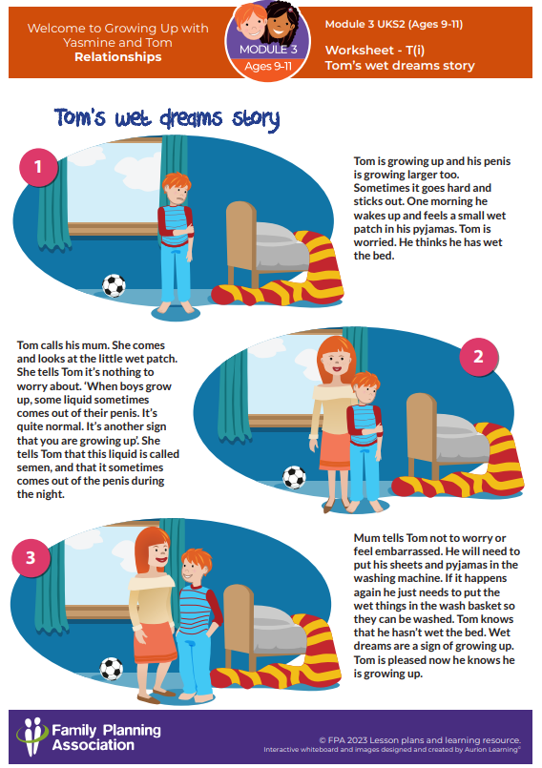
Year 5 Lessons – Changes at Puberty
Wet Dreams
Aim of lesson
To understand more about wet dreams and masturbation.
Learning outcome
I can explain what wet dreams are.
I can explain that some boys have wet dreams and some don’t.
I can suggest ways to manage wet dreams.
I can describe what masturbation is.

Slide 19
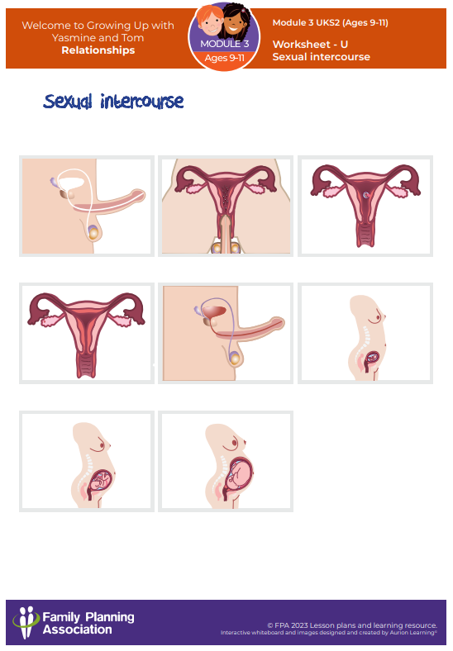
Year 6 Lessons – How Babies are Made.
→ Assisted Fertility and Multiple Births
Aim of lesson
To learn and understand how babies are made.
To learn about multiple births.
Learning outcome
I can explain that some people have help to become pregnant.
I can explain why some people need assistance to make a baby.
I can describe the difference between identical and non-identical twins.
→ Sexual Intercourse
Aim of lesson
To learn and understand how babies are made.
Learning outcome
I can describe fertilisation through sexual intercourse.
I can explain how a baby is made and that different people use different methods to do this.
I can describe what consent means.
I know the age of consent.
→ Pregnancy and Birth
Aim of lesson
To learn about pregnancy and how babies are delivered.
Learning outcome
I can say how long an average pregnancy lasts.
I can explain why a pregnancy lasts approximately 40 weeks.
I can identify and explain why some things that should and should not be eaten in pregnancy.
I can explain describe how babies are born (delivered).
I can work in a group.

Slide 20
You can access the DfE National Curriculum online.
https://www.gov.uk/government/publications/relationships-education-relationships-and-sex-education-rse-and-health-education

Slide 21
Thank you for attending
Please direct any questions to:
admin@bourton.school or attendance@bourton.school

