Slide 1
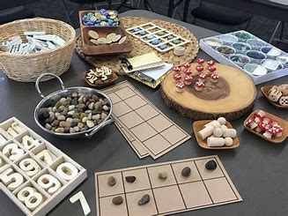
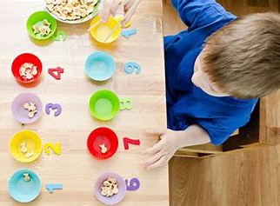
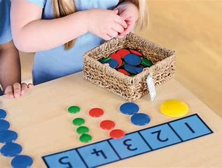
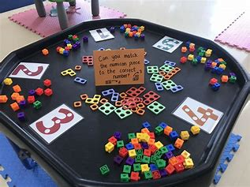
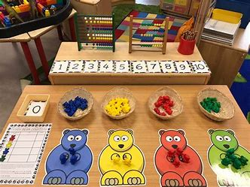
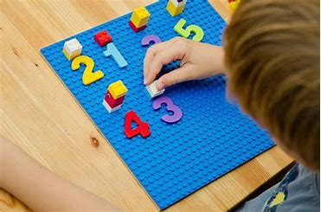
Maths in Reception

Slide 2
INTRODUCTION
In the Early Years Foundation Stage we teach using the DFE Statutory Framework for the Early Years Foundation Stage and the Development Matters Guidance.
The teaching of Mathematics in the Early Years Foundation Stage (EYFS) is split into 2 areas:
– Number
– Numerical Pattern

Slide 3
Number
By the end of the Reception year it is expected that most children will be able to achieve most of the following:
Have a deep understanding of number to 10, including the composition of each number.
Subitise (recognise quantities without counting) up to 5.
Automatically recall (without reference to rhymes, counting or other aids) number bonds up to 5 (including subtraction facts) and some number bonds to 10, including double facts.

Slide 4
Numerical Patterns
By the end of the Reception year it is expected that most children will be able to achieve most of the following:
Verbally count beyond 20, recognising the pattern of the counting system.
Compare quantities up to 10 in different contexts, recognising when one quantity is greater than, less than or the same as the other quantity.
Explore and represent patterns within numbers up to 10, including evens and odds, double facts and how quantities can be distributed equally.

Slide 5
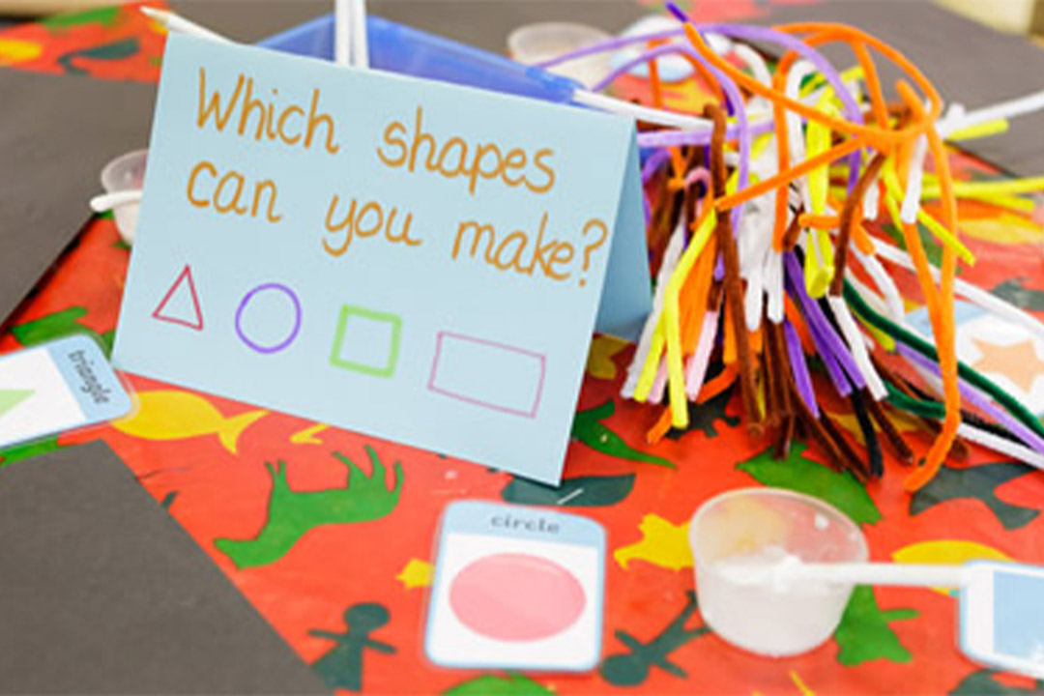
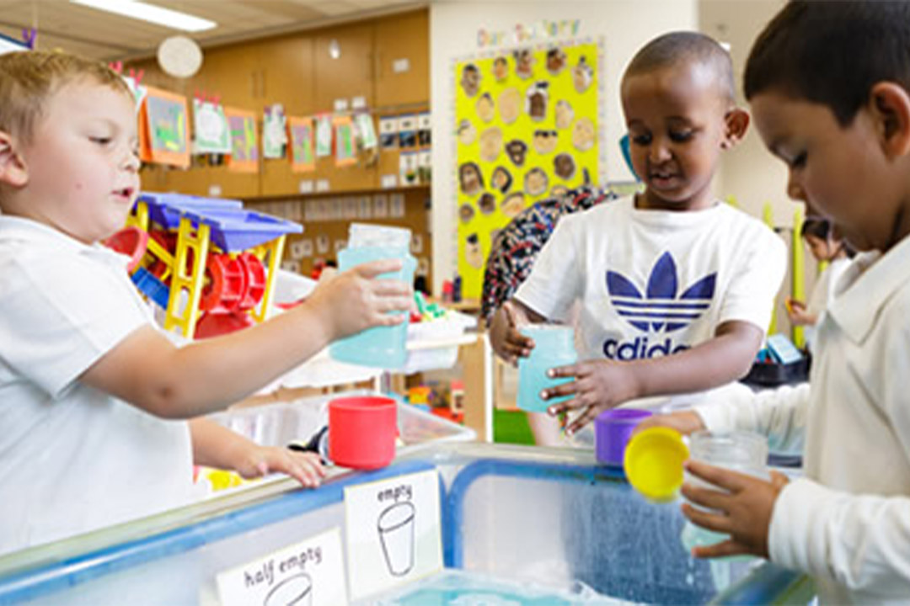
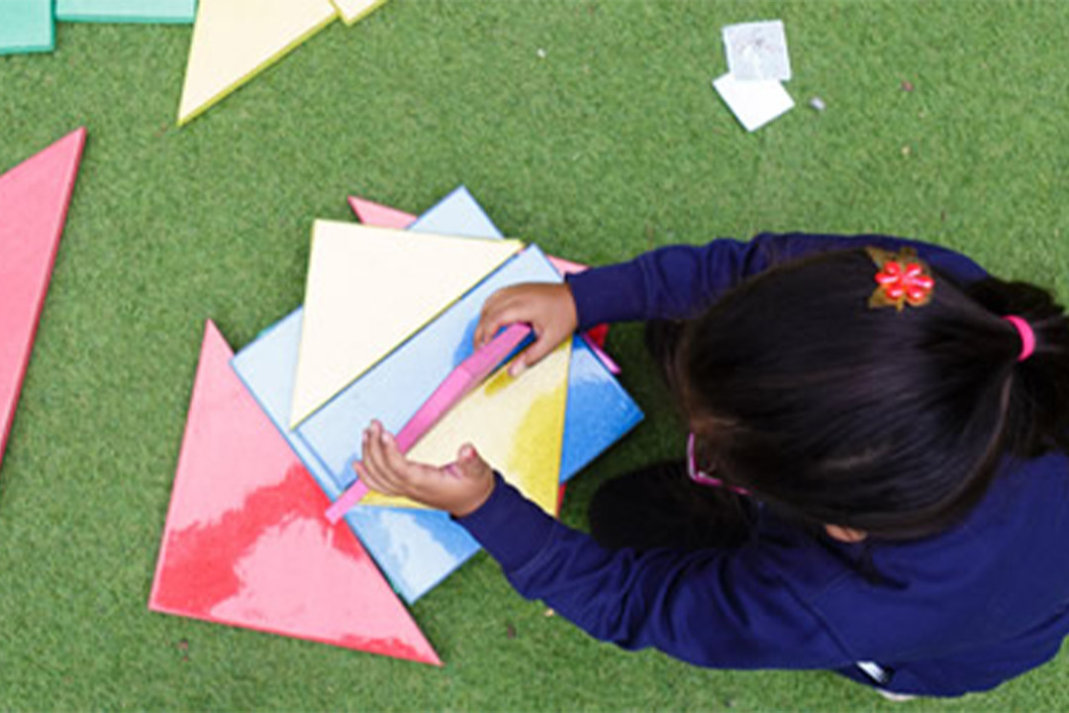
Each week focuses on one of 4 key concepts:
Subitising (knowing a number without counting “fast eyes”)
Composition (how a number is made)
Comparison (differences in numbers and quantities)
Counting, ordinality and cardinality (understanding how many things are in a group;
    understanding numbers in sequence;
    the quantity of things it represents e.g. “the three-ness of three”)
We will also cover:
Pattern
Shape and space
Measures

Slide 6
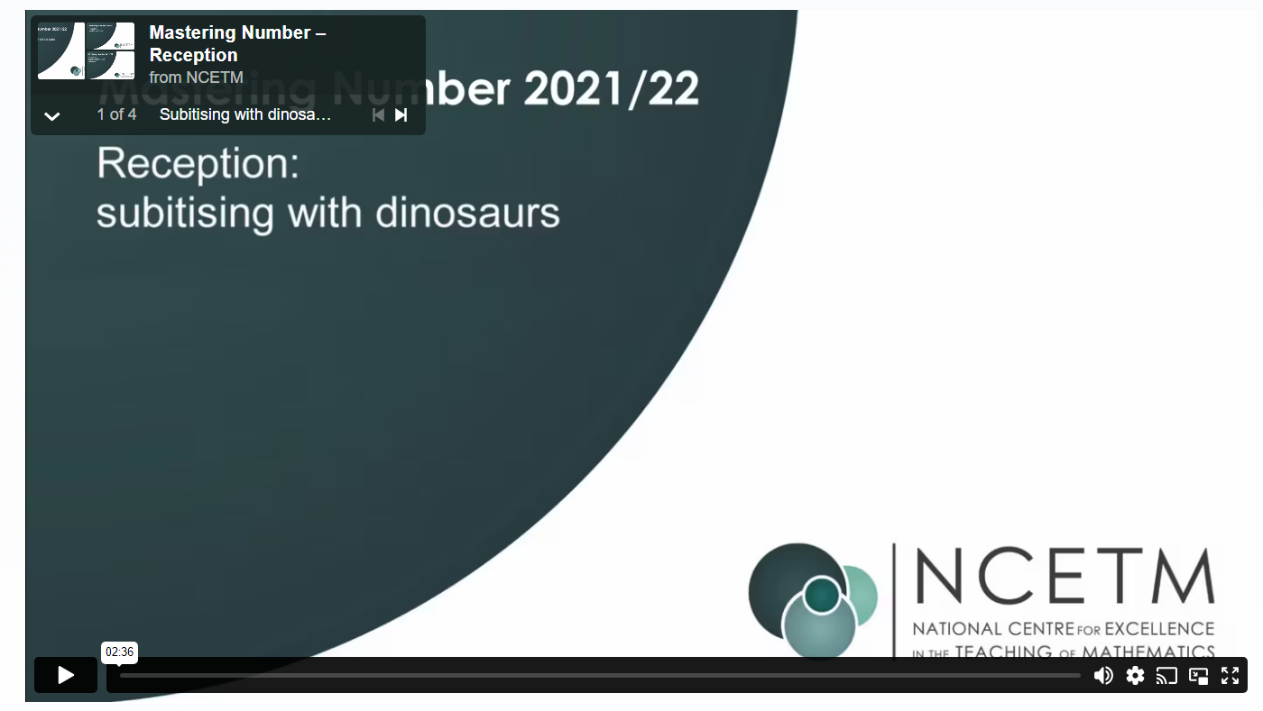
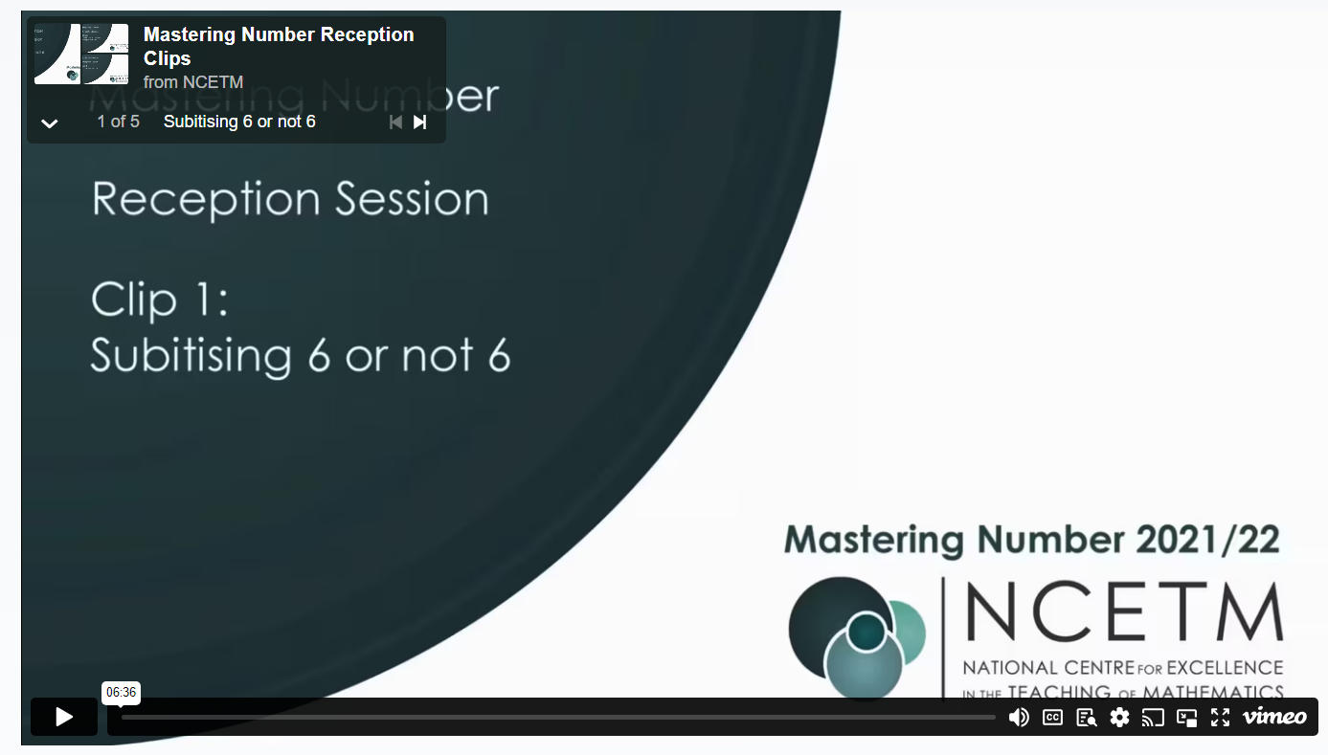
Subitising: using “fast eyes”
Children learn to recognise the number of objects in a group (up to five) without counting, through ‘hidden objects’ games and games using dice and dominoes. It is important that children develop strong images of familiar patterns, such as those on dice, but also that they see small numbers arranged in unfamiliar patterns.
Videos – Reception | NCETM Axis

Slide 7
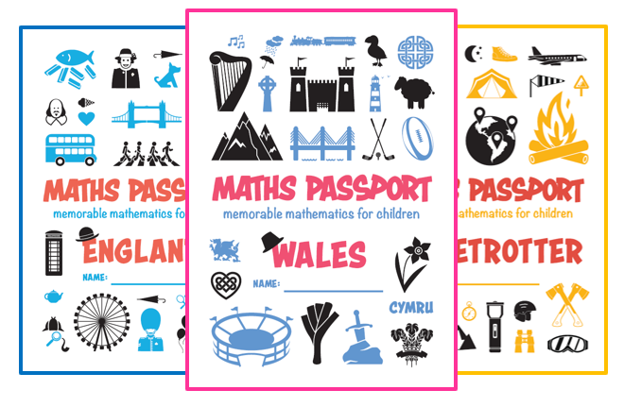
Maths Passport
Alongside our maths lesson we practise maths passport which is the mental arithmetic side of maths.
Maths Passport is a regular homework that will allow children to develop automaticity around counting, and continues through to Year 6. In reception, we have 5 passports: England, Scotland, Wales, Northern Ireland and Ireland.
Every child will be assigned a passport that they will take home (this will commence by the end of next week). We test the children every two weeks. You can write comments on the passport but PLEASE do not tick the targets – we will do this in school.
We need to see it three times before it is completely signed off.
Sometimes children will be able to achieve a target at home, but they do not show this at school, this can happen in different environments, until they are fully confident, so please don’t worry.
Things may change throughout the year as we are trialing other avenues with certain year groups.

